Slide 1
Identifying Competitive Neutrality of SOEs in China：
Cases of Several Industries
8 June, 2016
Mariko Watanabe
Gakushuin University , Japan

Slide 2
Target of this paper
Competitive Neutrality of SOEs?
  Identify competitive neutrality of SOEs in three electronics industries in the 2000’s China
  Alleged “predatory pricing”
What is done here?
  Quantifying the benefit / willingness to pay by estimating demand function
  Drawing “Price-Benefit” functions
  Built a simple model for “Neutrality” Violation with soft budget
What’s new?
  Utilizing structural estimation to capture “competitive neutrality”

Slide 3
Contents
Literature: SOE and Competition Neutrality
Research Strategy
Drawing Price-Benefit Curves and Competitive Positioning of brands
A Test on Anti Competition Condusts
Summary

Slide 4
１．Literature: SOE and Competitive Neutrality

Slide 5
Research Agenda
Why focusing on SOEs?
  SOE should be regulated?
  If yes, why and how?
History of Reform in China.
  Inefficient enterprise under planned economy
  Monopolistic behavior in Hu Jintao Era
    国進民退
  Ownership or competition?

Slide 6
Market vs State
Philosophy vs Practice
  Order to freedom vs Spontaneous order?
Externality
  Positive (good) externalities is utilized in “business models”
  Negative (bad) externality needs remedy
    Government or “contract”/”business models”
SOE
  Privatization or Competition Neutrality
  SOEs does not harm market competition.

Slide 7
3 types of Markets in China
Monopoly connected with political power
  E.g. Petro refinery, Railways, Telecommunication
“Bad” Mixed market
  Competition among heterogeneous entity, that is, SOE, Private, FOE.
  E.g. Electronics, Steel,
“Good” mixed market and Pure private market
  Internet, mobile phones

Slide 8
Different sources of problem?
Type 1 is notorious for their abusing power.
  Arbitrary price hike or supply suspension
  Violation of environmental regulation induces air pollution
To distinguish type 2 and 3 needs a theory.
  Does SOE harm market competition?
  Does ownership matters’ companies behavior?
  This paper focus on “identification” of this point.

Slide 9
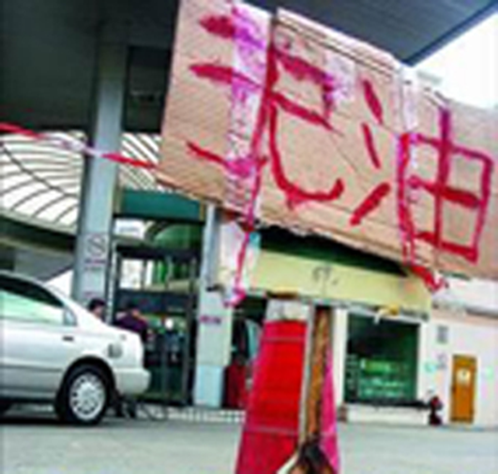
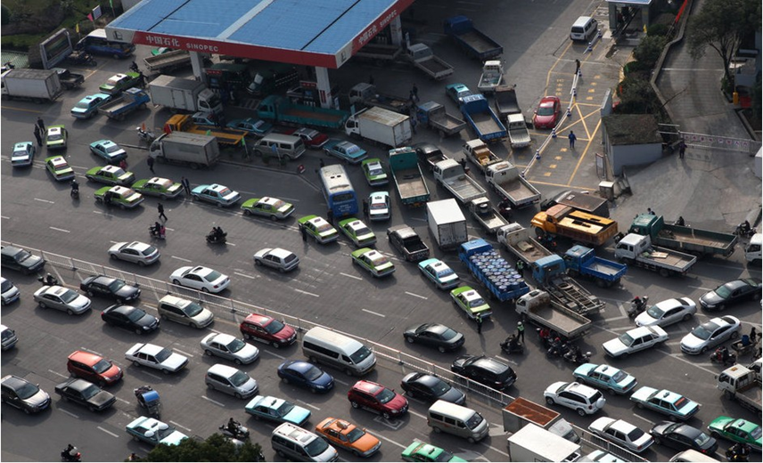
Monopoly: Gas shortage around 2005

Slide 10
SOE controls the standard
(Source: Caixin)
No. of person | Standard Setting Committee | Technical committee for petro energy
3 SOEs | 40 | 26
Univ. of Petro Chemicals | 1 | -
Automobile manufacturers | 1 | 3
Admin Environmental protection | 2 | 2
Admin Quality Inspection |  | 1
Electricity company |  | 1
PLA |  | 1
Head of Committee | Sinopec | Sinopec
Secretary | Sinopec | Sinopec

Slide 11
”Under the Dome”
SOEs conduct some time surpasses law
  Why PM2.5?
  Why environmental rule are violated ?
A documentary produced by Cai Jing
    https://www.youtube.com/watch?v=T6X2uwlQGQM
    Interviews with environmental protection department, NDRC, General engineer of Sinopec, around 51 min.

Slide 12
Literature: SOE and Competition
Mixed Market literature
  Outcome via competition among “profit maximizer” and “welfare maximizer”
    Matsumura and Matsushima (2004)
    Luts and Pezzino (2010)
    De Fraja (2009)
    Gosh and et.al (2015)
  Target: Public Utility industries: electricity
  NOT applicable to current China’s SOEs issue.
    China’s SOE has never required to maximize “welfare” until 2014.

Slide 13
Literature: SOE and competition
2. OECD’s Competition Neutrality Framework
  Corporate Governance to SOEs
  SOEs should maintain “competition neutrality”
  TPP are going to apply this principle.

Slide 14
Competitive Neutrality Framework
SOE should not enjoy competitive advantage thanks to their ownership.
SOE should comply with competition neutrality principle.
What conducts violate the neutrality?

Slide 15
Anti Competition Conducts
Chaporbianco and Christiansen (2011)
Predatory Pricing
  Set price unprofitably low so as to expel out the rivals
Raising rivals’ cost
Cross subsidies
  When SOE running on multiple market, give subsidies from one market to another so as to suppress the rivals
Strategic Adoption of inefficient technology

Slide 16
2. Research Strategy

Slide 17
How to identify competitive neutrality?
First, observe outcome of competition in a particular market
  Quantifying “Competitive Advantages”
    Estimating demand function
    Drawing Price-Benefit curve
  We found “excess price competition” or “predatory pricing” in some market.
Then, test hypothesis that might violate the competition neutrality.

Slide 18
Competitive Advantages by Porter
Benefit is bigger, Price is lower, CS is bigger.
  More right and lower, consumer surplus is bigger for consumers.
Competitive Advantages
  Cost Advantage Strategies
    Setting Lower price maintaining almost the same benefit
  Benefit Advantage Strategies
    Higher benefit maintaining almost the same price-level.
  Stuck in the middle
    No lower price, no higher benefit, least welfare

Slide 19
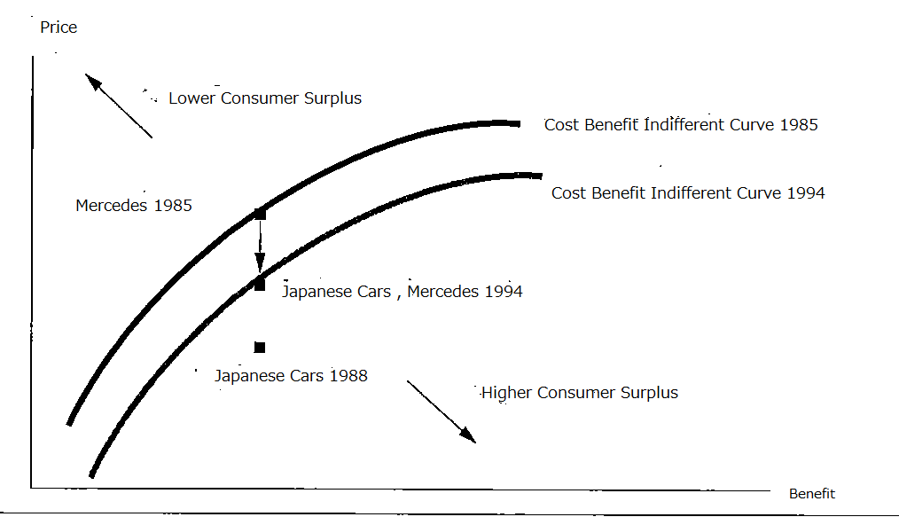
Competition Outcome:
Price-Benefit Curve
（Besanko et.al, Economics of Strategy）

Slide 20
Indifferent Curve and
Supply Curve
Price-Benefit Indifferent Curve:
  distribution of configuration of price and benefit with the same consumer surplus.
  It reveals “competitive positioning ” by Porter
Price-Benefit Supply Curve
  Pricing and Listing strategy by supplier
  It reveals “competitive condition” between price and benefit

Slide 21
Data
We utilizes 30 city market survey data from GfK research China.
  Air Conditioner 2000-2011
  Mobile Phone 2001-08
  Color TVs 2000-07
Demographic Data : China Urban City Statistical Yearbook
Ownership Data: Companies profiles.
Financial Statement of listed in China’ market

Slide 22
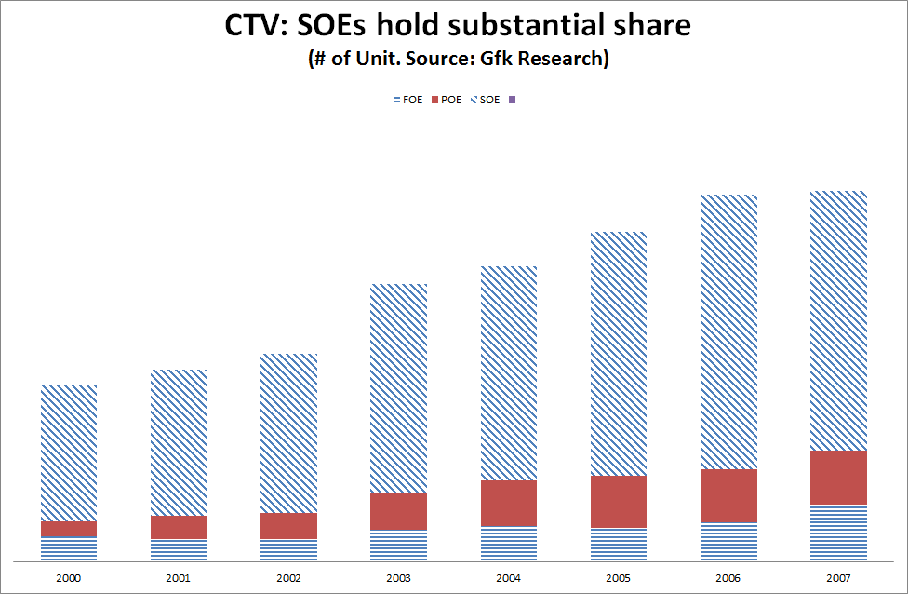
SOE holds major share

Slide 23
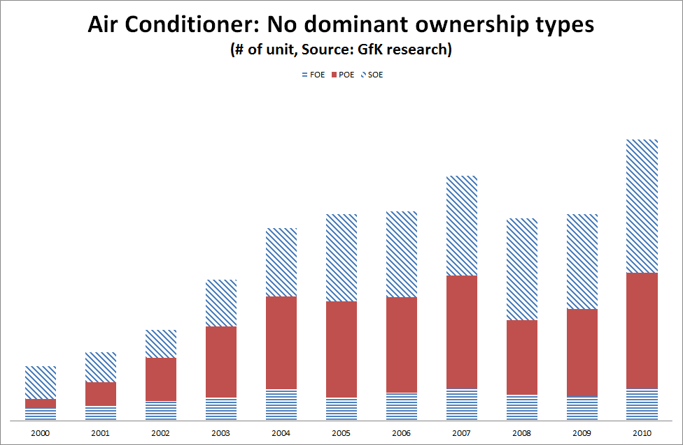
SOE, Private balanced

Slide 24
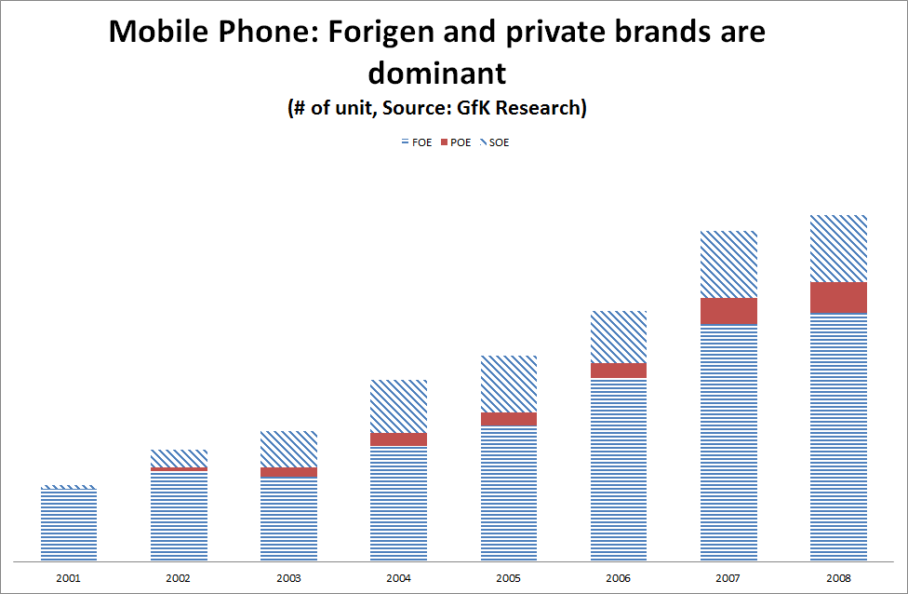
FOE dominant

Slide 25
Findings 1: Price Benefit Supply Curve

Slide 26
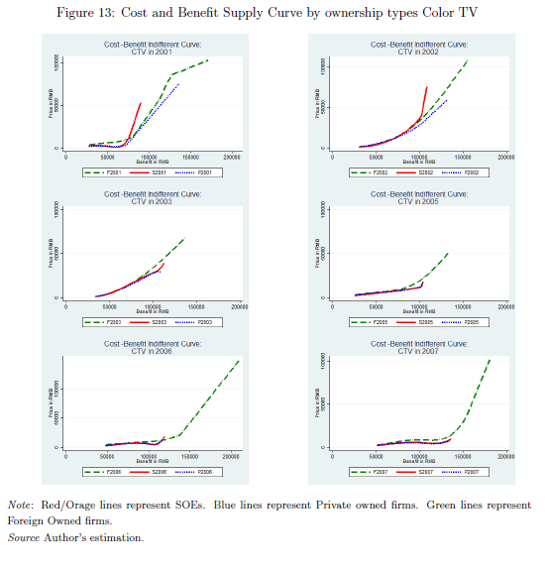
CTV: Benefit- Price Supply Curve
Supply curve of products configuration.
Price is independent to Benefit

Slide 27
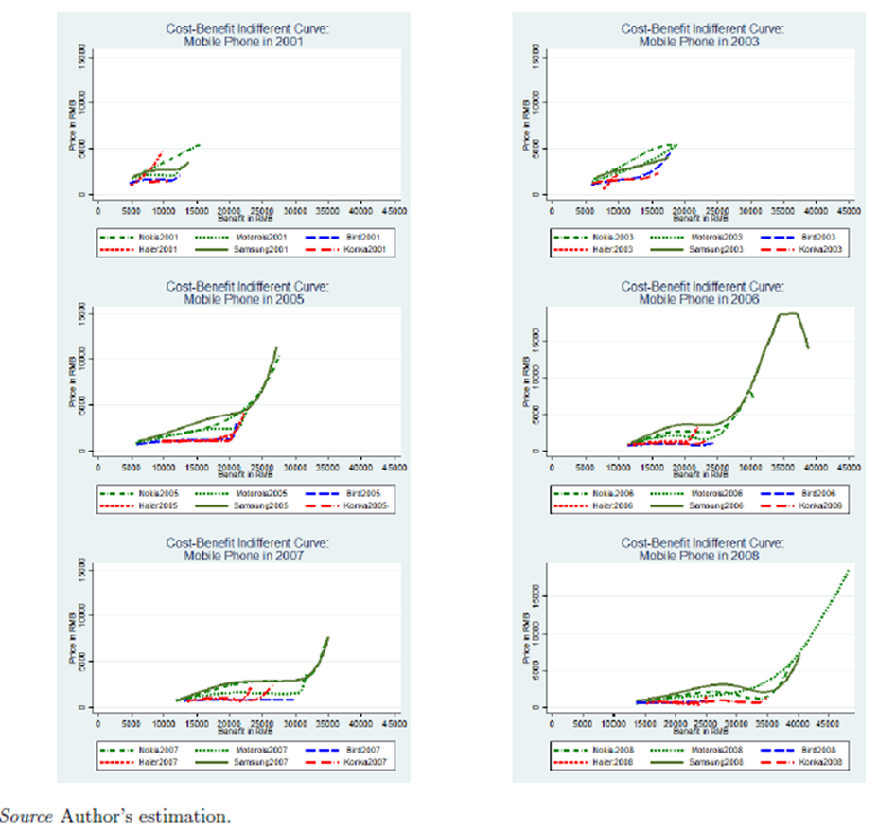
Mobile: Benefit-Price Supply Curve
FIE can price higher for higher benefit products
SOE and Private failed pricing higher for higher benefits.

Slide 28
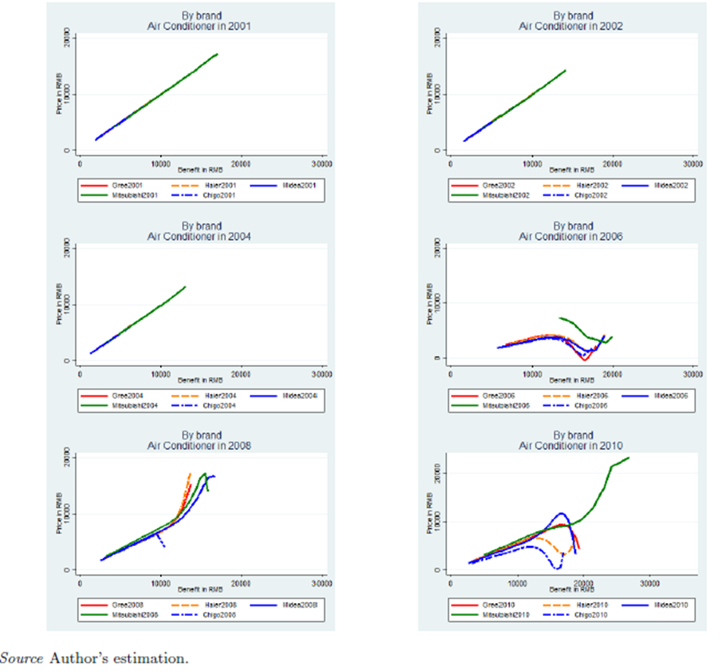
AC: Benefit price Supply Curve

Slide 29
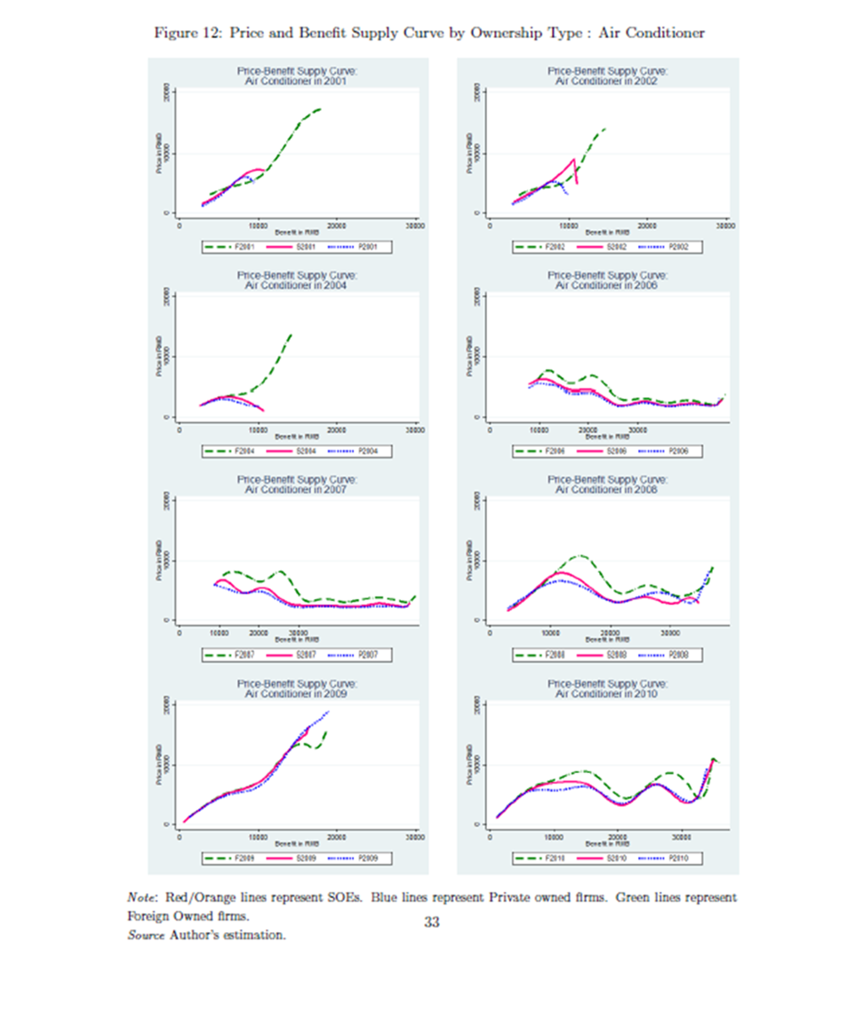
Benefit is proportionally priced to benefit.
Benefit is proportionally priced to benefit.

Slide 30
Findings from Supply Curve
Supply curves tends to get horizontal for SOEs and Private.
  Benefit does NOT priced positively priced
  Consumers values the benefit, but price is low.
  Supplier cannot get reward though they are supplying high benefit products
  Excessive price competition or predatory pricing?
  You need check “Consumer’s preference” first.

Slide 31
A Theory on horizontal Supply curve

Slide 32
Why supply curve get horizontal？
How to interpret this?
  Purely attributable to consumer’s preference?
  Outcome of Excessive price competition?
We need to distinguish hypothesis１and hypothesis 2 , that, good mixed market or bad mixed market.
  Horizontal supply curve = Weird pricing?
  Indifferent curve also goes horizontal.
  We need to borrow the power of economic theory.

Slide 33
Pricing at differentiated market
Hoteling model
  Firm A and B compete at differentiated market
  Best response of Firm A、B
    ｐ_{A}=ｐ_{B}＋ｃ_{A}＋ｔ_{B}＋（B_{A}-B_{B})
    ｐ_{B}＝ｐ_{B}+ｃ_{B}＋ｔ_{A}＋（B_{B}-B_{A})
  Market share at equilbrium
    Ｘ_{A}＝（ｔ_{B}+（B_{A}-B_{B})－（ｐ_{Aー}p_{B})）/（t_{A}＋ｔ_{B}）

Slide 34
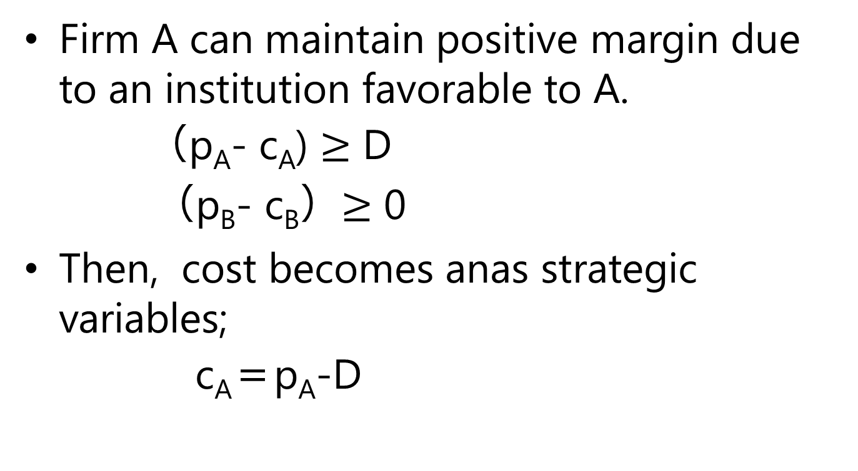
When Firm A’ faced with soft budget constraint
Firm A can maintain positive margin due to an institution favorable to A.
  （p_{A}- c_{A}) $≥$ D
  （p_{B}- c_{B}）$≥$ 0
Then, cost becomes anas strategic variables;
c_{A}＝p_{A}-D

Slide 35
Price and Market Share are function of subsidy
Prices and market share at new equilibrium.
  ｐ_{B}= ｃ_{B}-D＋ｔ_{B}＋ t_{A} eq (1)
  ｐ_{A}＝ｃ_{B}-2D+ｔ_{B}＋2_{A}＋（B_{A}-B_{B}) eq (2)
  x_{A} = D / (t_{A} + t_{B}) eq (3)
  Estimate these equations

Slide 36
Price and Market Share are function of subsidy
Margin at equilbrium
D = s/2 + (p_{A} - c_{A})
  s : Subsidy from the government. Firm B can lower their price by s.
  D：Realized margin with subsidy

Slide 37
FiNdings 2: Test on Price Benefit Curve

Slide 38
Structural Estimates
Debt and Price
  Debt negatively correlated to price for listed local brands
  Insignificant to non-listed firms
Predatory pricing behavior is not rejected.
Soft budget firm = listed local SOEs
  An arbitrary classification

Slide 39
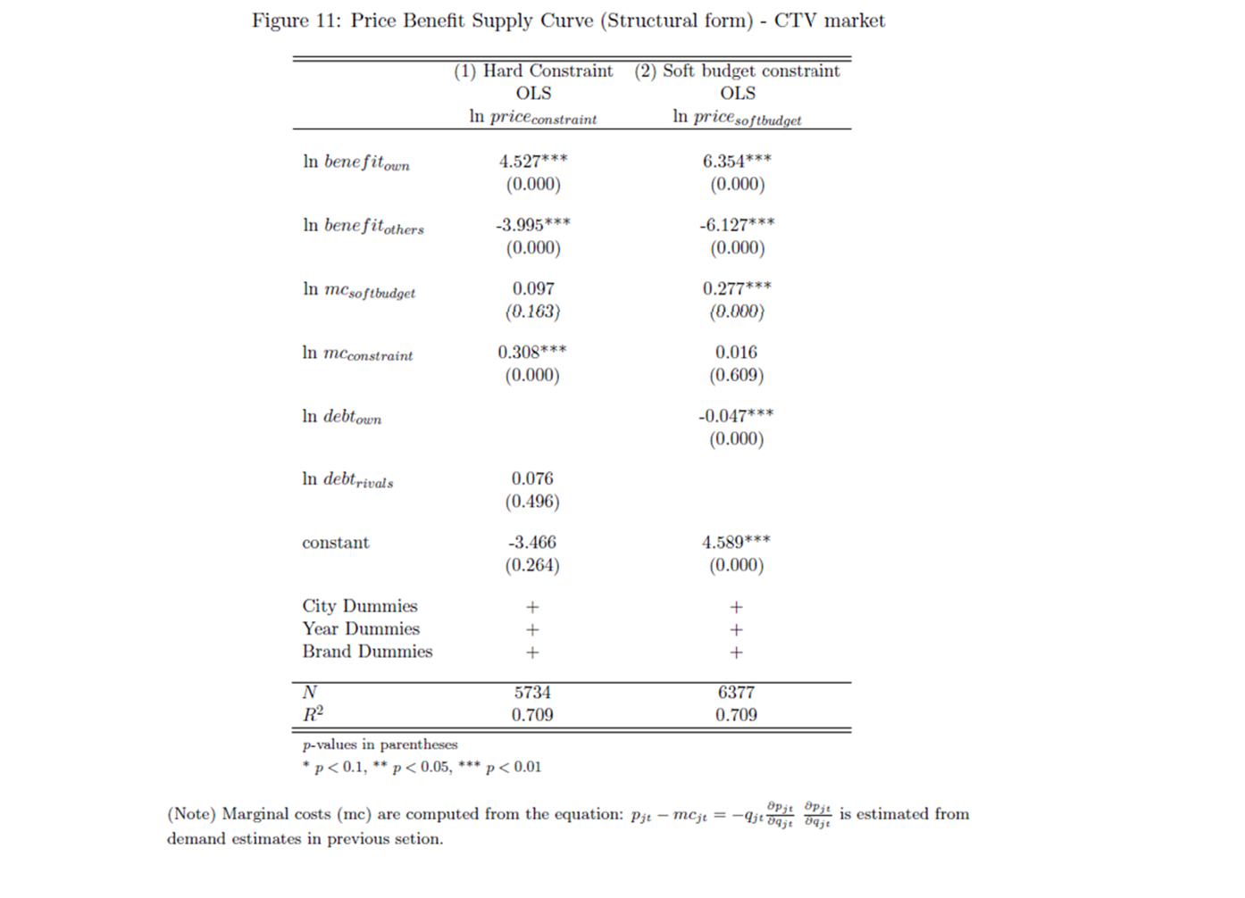

Slide 40
Application of the Proposition

Slide 41
Competitive Neutrality and Overcapacity
Competitive neutrality is also an alleged cause of overcapacity of some industry in China
  Iron and Steel industry
  An essay by Zhou (2006)
  Video “Under the Dome” implies a favorable “exit mechanism” for SOEs.

Slide 42
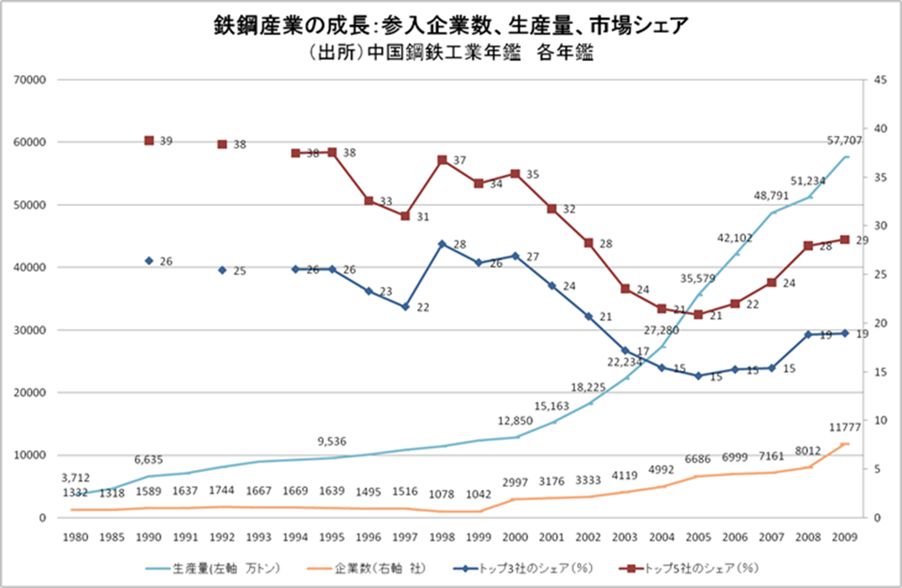

Slide 43
Planned research
Data available for differentiated production for individual brand
  x_{A} = D / (t_{A} + t_{B}) eq (3)
  Are going to test this equation so as to test “competitive non-neutrality.”
Does this nature connected with “over-capacity”?
  Need a theoretical check.
  Any comments welcome on this idea.

Slide 44
SUMMARY of FIndings

Slide 45
Summary of Findings of this paper
Competitive Advantages position in China market
  Local (SOE, POE) cost advantage strategy
  FI : Benefit advantage? Whole position strategy?
Possibility of “Excess Price Competition”
  Price benefit supply curves of CTV and Mobile look horizontal.
CTV market’s SOE, more debt amount, set price lower.
  Alleged Violation of market neutrality?

Slide 46
Policy Implication
Competition neutrality of China industries are diversified.
Favorable policy to SOE/ Discrimination of accessibility to finance is the cause of this behavior.
Equal market participation condition will benefit to China’s market welfare.

