Slide 1
Product and Process R&D under Asymmetric Demands
Wen-Jung Liang
Kuang-Cheng Andy Wang
Yi-Jie Wang
Bo-Yi Lee
Presented at Institute of Social Science,
The University of Tokyo
2015/04/08

Slide 2
Outline
Introduction: Motivation, market asymmetry, the barbell model, the purpose, part of the results in Lin and Saggi (2002), and the related literature.
Product R&D Only:
2.1. Bertrand Competition
2.2. Cournot Competition
2.3. Optimal Product R&D Investment in Different Competition Modes
Optimal Product and Process R&D Investments
4. Concluding Remarks

Slide 3
Motivation
Lin and Saggi (2002) utilized the demand function for differentiated products developed by Sing and Vives (1984) to study the equilibrium product and process R&D investments under Bertrand and Cournot competition.
In Lin and Saggi (2002), product R&D investment always expands the extent of horizontal product differentiation.
However, it can be found in the real world that many investments of product R&D are undertaken via shrinking rather than enlarging the extent of product differentiation.

Slide 4
Examples
HD DVD competed originally with Blu-ray Disc, in which both formats were designed as optical disc standards for storing high definition video and audio. In the end, the main developer of HD DVD, Toshiba, announced to stop the development of the HD DVD players in 2008, conceding the format war to Blu-ray disc.
Sony’s Betamax vs. JVC’s VHS in Cassette Recorder. In the end, Sony quitted producing Betamax.
By the Kantar Worldpanel’s report, 56% of European smartphone owners switched from a small sized smartphone of 4 or 4.4 inches to a larger sized in 2013, demonstrating that the large sized smartphone is a large market while the small sized is a small market.

Slide 5
Demand Asymmetry
It can be frequently observed in the real world that the demands for the differentiated products are asymmetric. For instance:
Coke had a 25.9 percent share of the soft drink worldwide while Pepsi had just 11.5 percent in 2011;
Google’s Android mobile operating system captured a 78 percent share of all smart phone users globally, while Apple’s iOS owned only 18 percent in the fourth quarter of 2013;
The large sized smartphone vs. the small sized smartphone.

Slide 6
The Barbell Model
Only two asymmetric markets located at the opposite endpoints of the characteristic line, respectively.
Each point along the characteristic line represents a distinct characteristic of the horizontally differentiated product.
Consumers incur disutility when they buy a non-preferred product deviated from their ideal product.
This disutility can be measured as the transportation cost between the non-preferred and the ideal products.
We can use the barbell model to describe the asymmetric demands for the differentiated products, and meanwhile the product R&D can be of either enlarging or shrinking the extent of horizontal product differentiation.

Slide 7
The Purpose
To construct a generalized model with market asymmetry by using the barbell model to examine the equilibrium product and process R&D, and to compare with the results derived in Lin and Saggi (2002).

Slide 8
Part of the Results Derived in Lin and Saggi (2002)
Bertrand firms invest more in product R&D, while Cournot firms conduct more in process R&D.
Equilibrium process R&D investment under Bertrand competition strictly increases with the extent of product differentiation.
Equilibrium process R&D investment under Cournot competition increases with the extent of product differentiation when the products are sufficiently differentiated (s < 2/3), while decreases otherwise.

Slide 9
Other Related Literature
Bester and Petrakis (1993): Cournot competition provides a stronger incentive to innovate process R&D than Bertrand competition if the degree of substitutability is low, while the reverse occurs otherwise;
Qiu (1997) : took into account the externality of process R&D;
Chen and Sappington (2010) examined the effect of vertical integration on the process R&D of the upstream firm;
Rosenkranz (2003) analyzed simultaneous product and process innovation if demand is characterized by preference for product variety;

Slide 10
Other Related Literature (Cont.)
Lambertini and Mantovani (2009): adopted a dynamic approach to explore the optimal process and product R&D in the long-run steady state for a multiproduct monopolist;
Chen and Sappington (2010): studied the effect of vertical integration on the process R&D of the upstream firm;
Ebina and Shimizu (2012): utilized a circular city model to show that the existence of spatial barrier will reduce the optimal product R&D under Cournot competition.

Slide 11
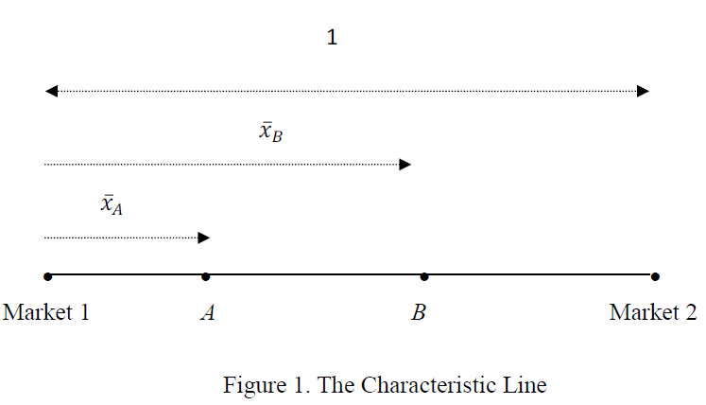
Product R&D Only:
The Barbell Model

Slide 12


The Barbell Model (Cont.)
The firms’ product R&D investment can be denoted as
where xi is firm i’s equilibrium characteristic.
The cost function for product R&D is given by where α > 0 denotes the cost parameter of product R&D.
The firms sell a product with a constant marginal production cost.

Slide 13
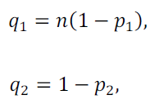
Asymmetric Demand Functions

Slide 14
The Game Structure
In the first stage, firms determine their optimal characteristic to maximize their profits.
In the second stage, given the characteristic decisions, the firms simultaneously choose their quantities (prices) if they engage in Cournot (Bertrand) competition.

Slide 15

Bertrand Competition
In stage 2, given the assumption xB ≥ xA, each firm will become a local monopolist in its advantageous market owning lower transportation cost under Bertrand competition, and the winner’s delivered price in its advantageous market equals the rival’s marginal cost as:

Slide 16
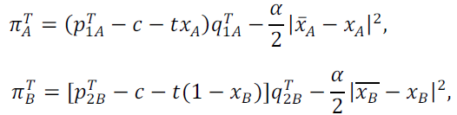

Profit Functions
In stage 1 the profit functions of firms A and B can be specified as follows:

Slide 17
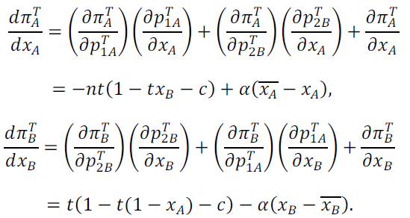

Profit-maximizing Conditions
Differentiating (4) with respect to xj, respectively, we can derive:

Slide 18
The Direct Effect
We find from (5.1) that firm A’s optimal characteristic is determined by the direct effect, which is the third term on the RHS of (5.1).
The direct effect consists of two opposite parts: the negative part and the positive part.
When xA becomes larger, the negative part arises from a decline in the operating profit caused by a rise in the distance from the large market, and then a larger transportation cost.
The positive part emerges because the fixed R&D cost reduces caused by a smaller product R&D.

Slide 19

The Second-order and Stability Conditions
The characteristic equilibrium is subject to second-order and stability conditions as follows:

Slide 20
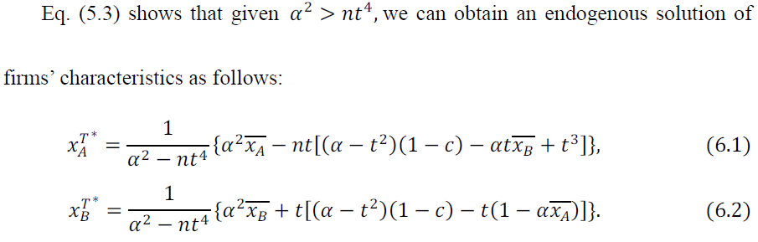
Optimal Characteristics

Slide 21




Optimal Characteristics (Cont.)
Next, provided that the cost parameter of product R&D is small, say,
the stability condition is violated so that the endogenous solution is no longer valid.
The candidate corner solutions are
The agglomeration solutions are infeasible.
Thus, the corner solution of firms’ characteristics must be

Slide 22

Proposition 1
Suppose that the firms undertake product R&D only and engage in Bertrand competition. The firms’ optimal characteristics will locate at the opposite endpoints of the line segment, when the cost parameter of product R&D is small, say , while they will locate inside the line segment as shown in (6) otherwise.

Slide 23
Cournot Competition
The profit functions for the Cournot firms:

Slide 24
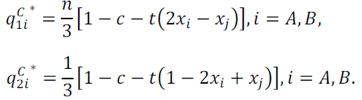
Optimal Outputs
In stage 2, we can solve for the equilibrium outputs as follows:

Slide 25
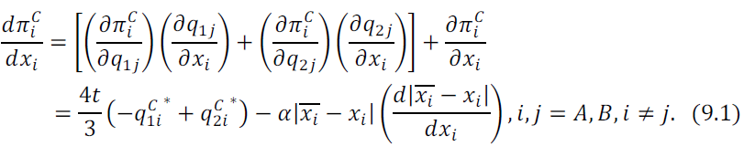
Profit-maximizing Conditions in Satge 1
In stage 1, by differentiating the profit function with respect to xi (i = A, B), we obtain:
The first term on the right-hand side of (9.1) can be referred to as the strategic effect.
The second term is the direct effect.

Slide 26
The Strategic and Direct Effects
The strategic effect: A rise in xi will increase the rival’s output in market 1 by increasing its transportation cost to market 1 and then reduce firm i’s profit, while will decrease the rival’s output in market 2 by the decline in the transportation cost to market 2 and then raise firm i’s profit. This strategic effect is negative if firm i’s output in market 1 is greater than that in market 2.
The direct effect: consisting of the impacts on the operating profit by increasing (decreasing) the transport cost to market 1 (2) and the R&D cost.

Slide 27
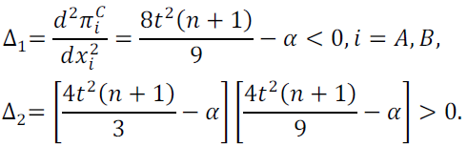
The Second-order and Stability Conditions

Slide 28


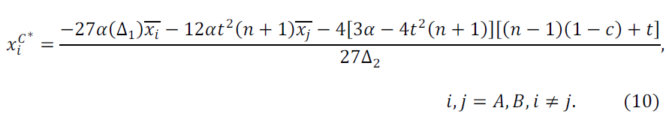
Optimal Characteristics
By (9.2) and (9.3), it is required:
Firm i’s optimal characteristic under Cournot competition is as follows:

Slide 29


Optimal Characteristics (Cont.)
Next, given the stability condition is violated so that the endogenous solution is no longer valid.
The candidate corner solutions are
Recall that xA ≤ xB . Provided that firm B locates at market 2, we can derive the difference in firm A’s profit between firm A locating at market 1 and market 2 as follows:

Slide 30
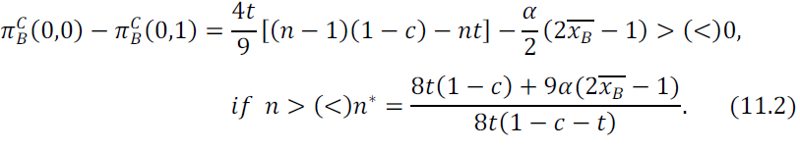
Optimal Characteristics (Cont.)
Similarly, given that firm A locates at market 1, we can derive the difference in firm B’s profit between firm B locating at market 1 and market 2 as follows:

Slide 31
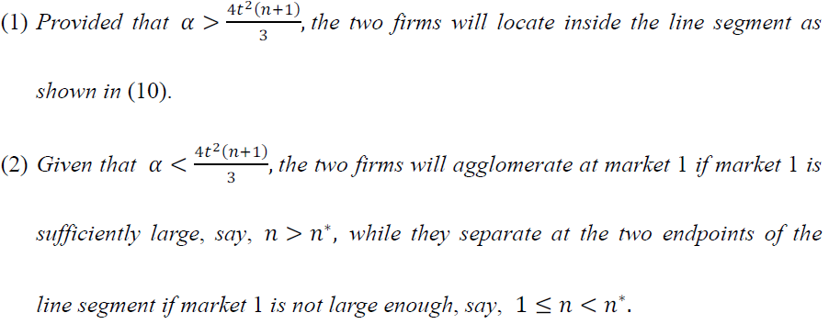
Proposition 2.
Suppose that the firms undertake product R&D only and engage in Cournot competition. We can propose:

Slide 32





The Case of and n > n∗
the optimal characteristic combination under Bertrand competition is
while that under Cournot competition is
The product R&D investments under Cournot competition are greater than those under Bertrand competition, because

Slide 33
The Case of and 1 < n < n∗
Both the optimal characteristic combinations under Bertrand and Cournot competition locate at the opposite endpoints of the line segment.
The aggregate product R&D investments under Cournot competition equal those under Bertrand competition.

Slide 34
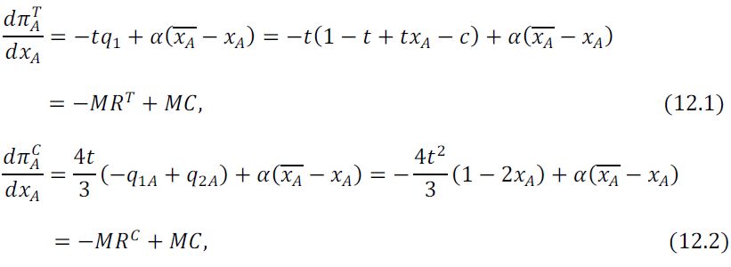
The case of n = 1 and
By substituting n = 1 into (5.1) and (9.1)gives:

Slide 35
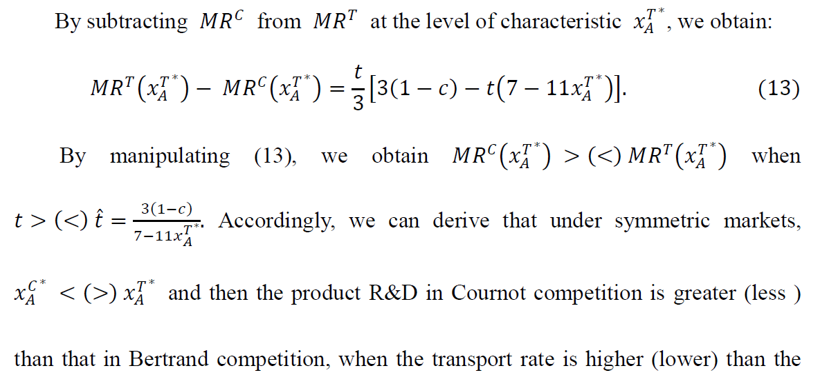

n = 1 and (Cont.)

Slide 36
The Intuition
As firms engage in price undercutting and each firm becomes a local monopolist, firms can earns a monopoly rent with limit price.
This monopoly rent is larger and the competition between firms is mitigated, when the transport rate, i.e., spatial barriers, is higher.
When the transport rate is high (low), Bertrand competition becomes less (more) competitive than Cournot competition.
The aggregate product R&D investments in Cournot competition are greater (smaller) than those in Bertrand competition.

Slide 37
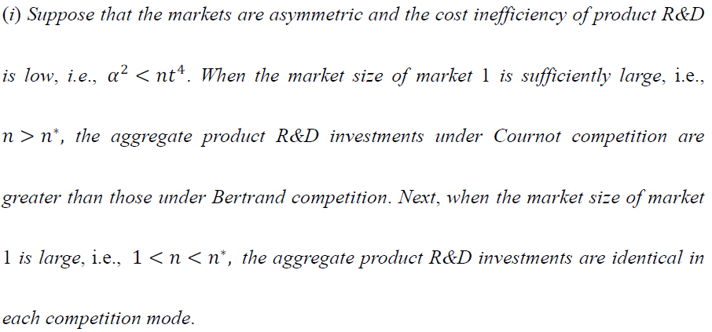
Proposition 3
Provided that the firms undertake product R&D only, we have:

Slide 38
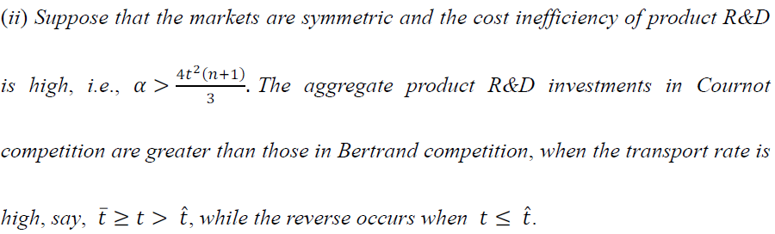
Proposition 3 (Cont.)

Slide 39
Compare with the Results Derived in Lin and Saggi (2002)
Proposition 3 is sharply different from the result derived in Lin and Saggi (2002), in which product R&D under Bertrand competition is always greater than that under Cournot competition.
The difference arises from the facts that product R&D is capable of making the products less differentiated and meanwhile spatial barriers are taken into account in this paper.

Slide 40

Product and Process R&D
Firm i’s process R&D investment is denoted as εi, which can reduce firm i’s cost to (c − εi).
The cost function of conducting process R&D can be expressed as

Slide 41
Game Structure
Firms choose their investments of product R&D in stage 1,
then they determine the optimal levels of process R&D in stage 2,
and finally they compete in the commodity market in stage 3.

Slide 42
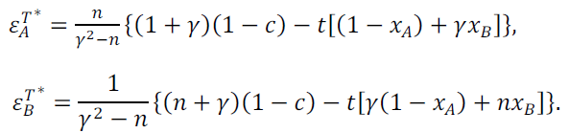

Optimal Process R&D under Bertrand Competition in Stage 2

Slide 43
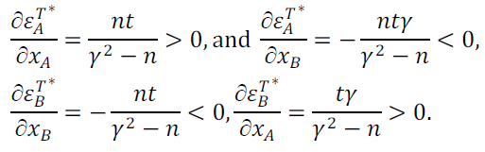
Comparative Statics
A rise in the horizontal differentiation between firms (declining xA and increasing xB) will reduce the optimal investments of the two firms’ process R&D.

Slide 44
The Intuition
A rise in the horizontal differentiation mitigates the competition in the market.
The two firms will raise prices to increase their profits, leading to the decrease in the two firms’ outputs.
It follows that the benefit of increasing process R&D declines.
As a result, the firms will reduce the investments of their process R&D.

Slide 45
Proposition 4
A rise in the horizontal differentiation will make the two firms reduce their optimal investments of process R&D under Bertrand competition.

Slide 46
Compare with the Results Derived in Lin and Saggi (2002)
Proposition 4 is significantly different from the result in Lin and Saggi (2002), in which equilibrium process R&D investment strictly increases with the extent of horizontal differentiation.
The difference occurs because a rise in horizontal differentiation will make both firms’ demand curves shift outward and then increase outputs in Lin and Saggi (2002).

Slide 47
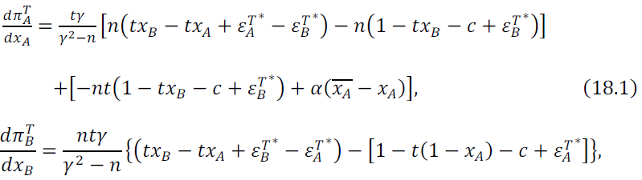
Optimal Characteristics in Stage 1

Slide 48
Optimal Characteristics (Cont.)
The first term on the right-hand side of (18) can be referred to as the strategic effect, while the second term is the direct effect.
We find from (18) that the optimal firms’ characteristics under Bertrand competition will locate at the opposite endpoints of the line segment, respectively, if the cost parameter α is sufficiently small, while they will locate within the line segment otherwise.

Slide 49
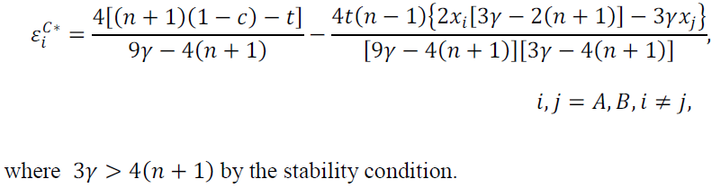

Optimal Process R&D under Cournot Competition in Stage 2
In stage 2, the optimal process R&D under Cournot competition can be derived as follows:

Slide 50
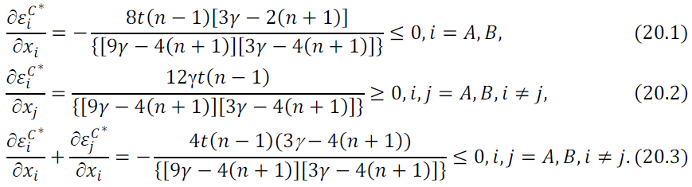
Comparative Statics

Slide 51
The Intuition
Declining xA will increase (decrease) firm A’s output in the large (small) market while has opposite effect to firm B via reducing (enlarging) firm A’s transportation cost to the large (small) market.
The rise in the output of the large market is greater than the decline in the small market, the net output of firm A will increase. Thus, firm A’s process R&D investment rises.
Contrarily, firm B’s process R&D investment declines.
However, the former outweighs the latter so that the aggregate process R&D investment enhances.

Slide 52
Proposition 5
A rise in the horizontal differentiation will increase firm A’s optimal process R&D investment while decrease that of firm B under Cournot competition, when the markets are asymmetric. Moreover, the aggregate process R&D investment enhances (reduces), when the rise in the horizontal differentiation is caused by declining xA (increasing xB). However, it generates no effect to each firm’s as well as the aggregate optimal process R&D investment, when the markets are symmetric.

Slide 53
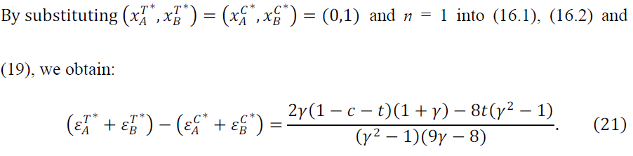



The Case Where n = 1 and α Is Sufficiently Small
The two firms’ optimal aggregate process R&D investments under Bertrand competition are greater than those under Cournot competition if while the reverse occurs if

Slide 54
The Intuition
The higher the transport rate is, the larger will be the equilibrium delivered price.
The equilibrium delivered prices under Bertrand competition will be lower (higher) than those under Cournot competition such that the aggregate outputs and the returns from process R&D under Bertrand competition will be greater (smaller) than those under Cournot competition, when the transport rate is lower (higher) than t∗.
As a result, the optimal aggregate process R&D investments under Bertrand competition will be greater (less) than those under Cournot competition, when t < (>) t∗.

Slide 55

Proposition 6
Suppose that the markets are symmetric and the cost parameter of product R&D is sufficiently small such that the two firms’ optimal product characteristics separate at the endpoints of the line segment, respectively, regardless of the competition mode. The two firms’ optimal aggregate process R&D investments under Bertrand competition are greater than those under Cournot competition if

Slide 56
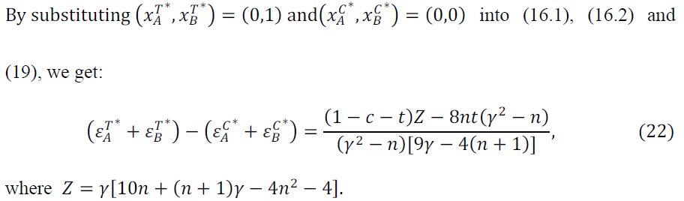


Optimal Aggregate Process R&D When n Is Large and α Is Small under Bertrand Competition
By manipulating, we derive from (22) that
Thus, the two firms’ optimal aggregate process R&D investments under Bertrand competition are less than those under Cournot competition if n > n∗∗ .

Slide 57
The Intuition
When market 1 is sufficiently large, the two firms’ characteristics will agglomerate at market 1 under Cournot competition, while they separate at the opposite endpoints of the line segment, respectively, under Bertrand competition.
The competition in the large market becomes more severe under Cournot competition than under Bertrand competition.
This will result in a larger aggregate output and higher returns from process R&D under Cournot than under Bertrand competition, if the market is sufficiently large, say, n > n∗∗ .

Slide 58
The Intuition (Cont.)
Next, provided that n < n∗∗ such that Z > 0, we can calculate that when the transport rate is low, the two firms’ optimal aggregate process R&D investments under Bertrand competition are greater than those under Cournot competition, while the reverse occurs otherwise.
The same intuition in Proposition 6 carries over to this result.

Slide 59

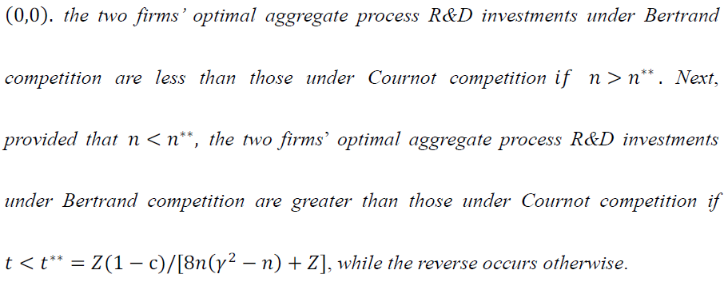
Proposition 7
Suppose that market 1 is sufficiently large and the cost parameter of product R&D is sufficiently small such that

Slide 60
Concluding Remarks
This paper has indicated that Lin and Saggi (2002) miss analyzing the possibility that product R&D investment can shrink the extent of horizontal product differentiation, and adopts the barbell model with asymmetric demands a la Liang et al. (2006) to examine the optimal product and process R&D investment under Bertrand and Cournot competition.

Slide 61
Main Results
Suppose that the markets are asymmetric and the cost parameter of product R&D is small. When market 1 is sufficiently large, the aggregate product R&D investments under Cournot competition are greater than those under Bertrand competition.
Suppose that the markets are symmetric and the cost parameter of product R&D is large. The aggregate product R&D investments in Cournot competition are greater than those in Bertrand competition when the transport rate is high, while the reverse occurs otherwise.

Slide 62
Main Results (Cont.)
A rise in horizontal differentiation will lead the two firms to the reduction of their optimal process R&D investments under Bertrand competition.
Provided that market 1 is not very large and the cost parameter of product R&D is small, the two firms’ optimal aggregate process R&D investments under Bertrand competition are greater than those under Cournot competition if the transport rate is small, while the reverse occurs otherwise.

Slide 63
Thank you

